Slide 1
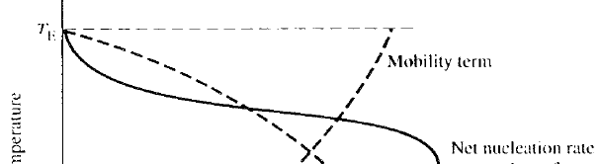
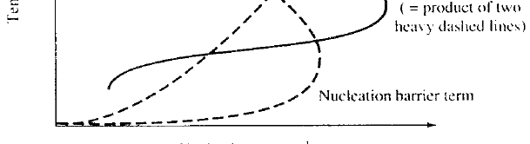
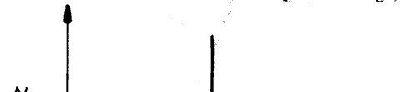
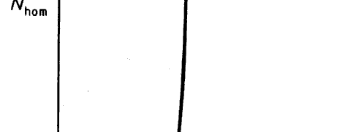

Homogeneous Nucleation (VII)
Until a certain undercooling, the nucleation rate is virtually zero and then increases
very rapidly.
Due to the exponential dependence a minor change in ΔG* or ΔT may result in a
change of several order of magnitude in the nucleation rate.

After critical undercooling for homogeneous nucleation ΔT_{N} is reach, there is
an explosion of nuclei.
At very large undercoolings (at lower temperatures) the atomic mobility (diffusion)
is reduced and it controls the nucleation rate.  a maximum curve
Solidification of materials
1

Slide 2

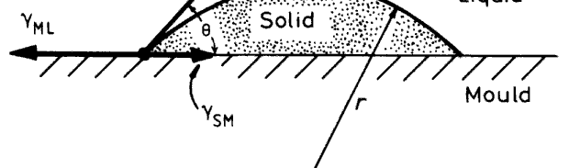
Heterogeneous Nucleation (I)
In engineering practice, many liquid metals start solidification in a few degrees
of supercooling. The thermodynamic barrier for nucleation in this case is
smaller than calculated critical free energy change ΔG* by homogeneous
nucleation theory.
Nucleation usually starts on the crucible wall, on solid inclusions suspended
in the melt or on a solid surface layer (e.g. oxide layer).
Nucleation on a foreign substance is known as heterogeneous nucleation.
a spherical cap shaped nucleus is forming in a flat inclusion surface
γ_{ML} γ _{SM}
Force balance
=
+ γ _{SL} cos θ
The free energy change during the heterogeneous nucleation
ΔG = −V_{S} ΔG_{V} +
A_{SL} γ _{SL} A_{SM} γ _{SM} A_{SM} γ_{ML}
+
−
V_{S} : volume of nucleus
₌ ¹ _{πr}³ _{(2 + cos θ)(1− cos θ)}²
3
A_{SL} : surface area of spherical cap
2
= 2πr (1− cos θ)
A
: surface area of nucleus-inclusion contacting area
= πr² sin² θ
A i l i t ti i
SM
Solidification of materials
2

Slide 3
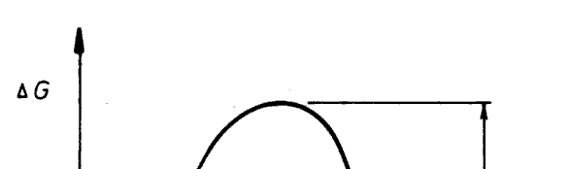
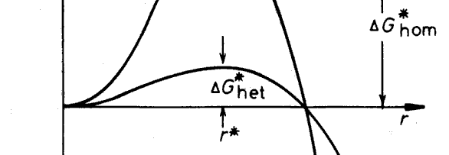
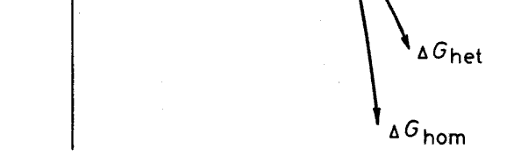
Heterogeneous Nucleation (II)
ΔG = −V_{S} ΔG_{V} +
A_{SL} γ _{SL} A_{SM} γ _{SM} A_{SM} γ_{ML}
+
−
= ⁴ πr³ ΔG + 4πr² γ
⎡−
⎤
S(θ)
⎢⎣ 3 ^{V SL}
=
ΔGhom
shape factor
S(θ) = (2 + cos θ)(1− cos θ)² / 4 ≤ 1
r* and ΔG* are estimated as follows
2γ _{SL} ⎛ 2γ _{SL} T_{m} ⎞ 1
2 1
r∗
=
=
⎜
⎝
⎟ ΔT
= r∗
het
ΔG
V
L
⎠
hom
16πγ ³
ΔG∗ = ^{SL} S(θ) = ΔG∗
S(θ)
het
3(ΔG
V
)²
hom
⎛
πγ ³
² ⎞
=
⎜ ^{16 T} ⎟ ¹ S(
θ)
⎜
SL m
3L^{2 ⎟} (ΔT)²
⎝
⎠
The critical nucleus radius r* is unaffected by heterogeneous nucleation and
only depends on the undercooling (ΔT).
The activation energy barrier against heterogeneous nucleation (ΔG*_{her}) is
smaller than ΔG*_{hom} by the shape factor S(θ).
if θ = 10º , S(θ) =
10⁻⁴
;
if θ = 30º , S(θ) = 0.02 ;
if θ = 90º , S(θ) = 0.5 ;
if θ =
0º
, S(θ) = 0
;
if θ = 180º (non-wetting), S(θ) = 1
θ wetting) θ =1
Solidification of materials
3

Slide 4
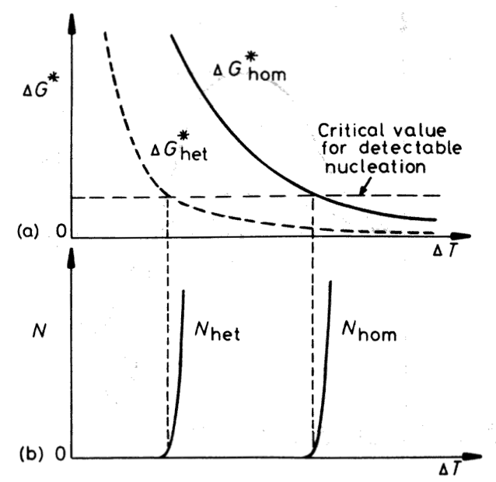
Heterogeneous Nucleation (III)
Nucleation Rate for Heterogeneous Nucleation
The number of nucleus at critical radius in liquid, n*
ΔG∗
G
n∗
= n exp(− ^{het} )
1
kT
n₁ : the total number of atom around the incubating agents’ surface in liquid
P : frequency of the addition of a single atom to a critical nucleus
P =
¹n
να exp(−
^{ΔGi} ₎
kT
6
L
Nucleation rate,
Nhet
∗
N = n P ≅
n₁kT
h
exp(− ^{ΔGhet} )
het
r
kT
3 2
≅
n₁kT
h
exp⎡− ^{A} S(θ)⎤
A =
16πγ _{SL} T_{m}
⎢
(ΔT)
2
⎥
3LkT
⎣
⎦
Heterogeneous nucleation needs small
supercooling to stimulate.
The smaller the wetting angle is the
smaller supercooling needed.
Solidification of materials
4

Slide 5
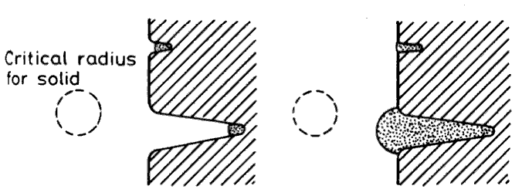
Heterogeneous Nucleation (IV)
Factors Affecting Heterogeneous Nucleation
(1) Wetting angle (θ)
In heterogeneous nucleation, the smaller wetting angle (θ), the smaller ΔG*
and therefore the nucleation is easier.
Low value of θ are favored by a low-energy interface between the
γ_{ML} γ _{SM}
inoculation and solid nucleus (γ_{SM}) 
=
+ γ _{SL} cos θ
 good lattice mismatching between particles and solid (coherent
interface), chemical effects as well as surface segregation and roughness

(2) Surface roughness and geometry
If a nucleus forms at the root of a crack, the critical volume can be very
small even if the wetting angle is quite large.  Nucleation from cracks
and crevices should be able to occur at very small undercooling.
The upper nucleus cannot grow out of the crack while the lower one can.
(3) Grain refiner
The inoculating agent forms a solid compound with one of components of the melts  acting as a sitr for nucleation
The effects of inoculating will be reduced by a high temperature of melt
and a long time period.
(4) Heterogeneous nucleation by ultrasonic vibration
Solidification of materials
5

Slide 6
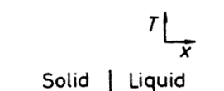
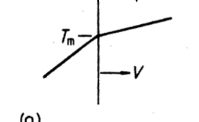
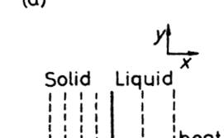
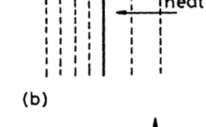
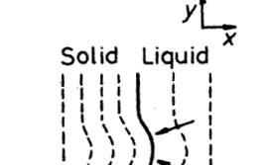
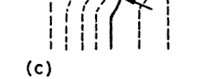
Heat Flow & Interface Stability (I)
In pure metals, solidification is controlled by the rate at which the latent heat
can be conducted away from the solid/liquid interface
Case 1. Heat Extraction through Solid
(solidification takes place from the mold walls)
Solid grows at a velocity (v) with a planar interface
into a superheated liquid
Heat flow away from the interface through the solid
= Heat from the liquid + Latent heat generated at interface
nterface
K_{S}T_{S}′ = K_{L}T_{L}′ + vL_{v}
K : heat conductivity,
T' : temperature gradient (dT/dx)
Suppose that a small protrusion forms at the interface
S th t ll t i f t th i t f
as a result of a local increase in v (ignoring the
Gibbs-Thomson effect)
Temperature gradient in the liquid ahead of the nodule will increase while that in the solid

d l ill i hil th t i th lid
decreases.
More heat will be conducted into the protruding
solid and less away so that the growth rate will
decrease below that of the planar regions

decrease below that of the planar regions

The protrusion will disappear  planar S/L interface
Solidification of materials
6

Slide 7
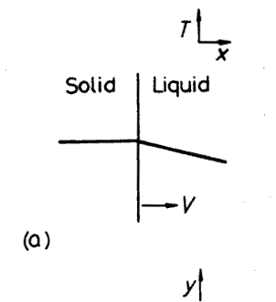
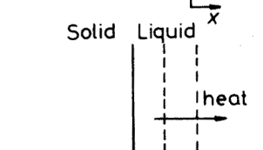
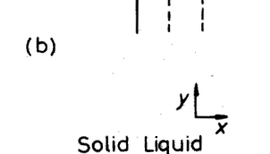
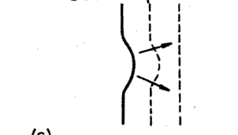
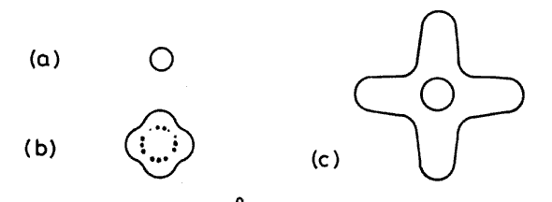

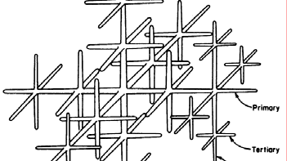

Heat Flow & Interface Stability
(II)
Case 2. Heat Conduction into Liquid
(nucleation occurs at impurity particles in liquid)
Solid grows into supercooled liquid below T_{m}
If a protrusion forms on the solid in this case, the
negative temperature gradient in the liquid
becomes even more negative.
Heat removed more effectively from the tip of the protrusion than from the surrounding regions


The protrusion grows preferentially and a S/L
interface advancing into supercooled liquid is
inherently unstable
Spherical solid particles will grow into liquid

supercooled liquid, and develop arms in many
directions
As the primary arms elongate, their surfaces will also unstable and break up into secondary and

even tertiary arms.
Dendrite (meaning tree)
Thermal dendrite in pure metals


Solidification of materials
7

Slide 8
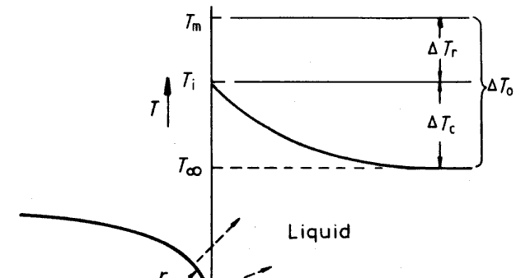
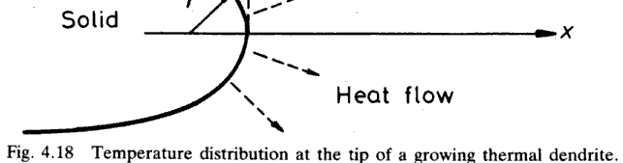
Growth of Dendrite (I)
Dendrite in pure metals  Thermal undercooling
Dendrite in alloys  Constitutional undercooling
Dendrite arms are always in certain crystallographic directions:
eg. <100> in cubic, <1-100> in hcp
At the tip of growing dendrite
- Heat conducting away from the tip
- Assuming isothermal in solid (dT/dx = 0)
- Growth rate of dendrite tip
At the tip of growing dendrite
dT_{S}
0
= K
^{dTL} +
K
S
dx
L
dx
vL
v
∴ v =
K_{L} dT_{L}
L_{v} dx
^{dTL} ≅ ^{ΔTC}
will give
dx
r
∴ v =
K_{L}
ΔT_{C}
L_{v}
r
For a given ΔT, rapid growth will be favored by a small values of r
due to the increasing effectiveness of heat conduction (increasing dT_{L}/dx )
However, ΔT is not independent of r, because of the Gibbs-Thomson effect.
Solidification of materials
8

Slide 9
Growth of Dendrite (II)
 Gibbs-Thomson effect : Curvature dependence of melting temperature
2 γ T_{m}
ΔT =
r
L_{v} r
 Equilibrium across a curved interface occurs at an undercooling ΔT_{r} below T_{m}.
The minimum possible radius of curvature of the tip is when ΔT_{r} = ΔT₀ (such as
T_{m}-T∞),
r∗
=
2 γ T_{m}
L_{v} ΔT₀
In general ,
ΔT
r∗
and ΔT₀ = ΔT_{C} + ΔT_{r} ,
ΔT =
0
r
r
K ΔT
K ΔT
⎛
r∗
⎞
∴ v =
L C L 0
⎜1−
⎝
⎟
⎠
L_{v}
r
≈
L_{v}
r
r
r  r* , tip velocity tends to zero due to the Gibbs-Thomson effect
 ti l it t d t d t th Gibb
r ∞ (planar interface), tip velocity tends to zero due to slower heat conduction
The maximum velocity is obtained when r = 2r*,
Solidification of materials
9

